Slide 1
Capstone of Sravan Borra
Statistics & Modeling
Coding with Performance on Big Data
Communicating Results for Decision-Making
Venn Diagram of Data Science Skills

Slide 2
Contribution of Competitor’s Article
Title: Study of ANFIS Model for Weather Forecasting in Dhaka
Data set: Ten years of weather data (2000-2009) of Dhaka
Aim of the article: Predicting maximum and minimum temperature using ANFIS.
Parameters used are MAE, RMSE, SSE.
ANFIS: Combination of fuzzy logic and Neural networks
As we use in neural networks, in this article they used four inputs and one output.
The prediction done by competitor was a long range prediction which has more error.

Slide 3
Description of Your Contribution
Step-1: Cleaning the data
‘Json’ format
Converted to TIMEDATE format using python in Zeppelin.
Step-2: Studying the data (Used R)
Finding the correlation between the variables.
Applying PCA.
Step-3: Building an equation on which we can apply regression and time series analysis.
Step-4: Applying time series analysis
ARIMA
Used R
Step-5: Comparing the results with competitors article.
Start
Cleaning the data
Studying Data
Equation
Applying ARIMA
Results
End

Slide 4
Data Source and Content
Weather data
City- Aarhus in Denmark
Aim: To predict Maximum and Minimum Temperature using time series Analysis.
Duration of the dataset:
February 2014 - June 2014
August 2014 - September 2014
Contents of Data set(JSON Format):
Dew Point
Humidity
Pressure
Temperature
Wind Direction
Wind Speed.

Slide 5
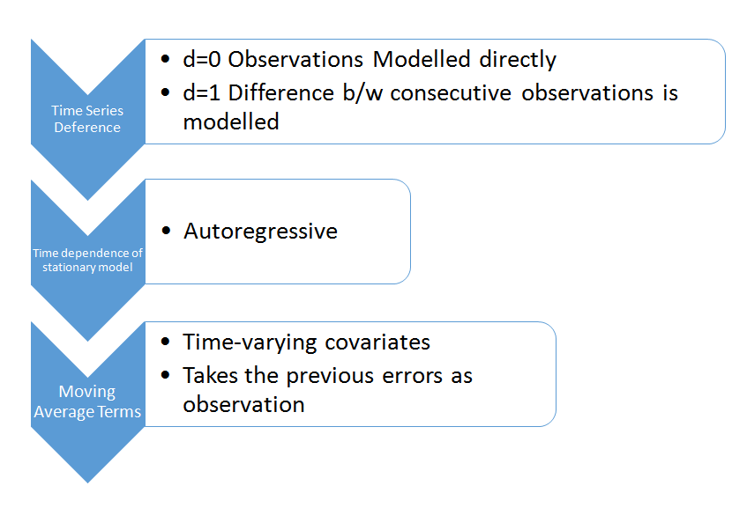
Your Method
Method: Time series Analysis Using ARIMA.
Parameters used for comparing ARIMA and ANFIS
Mean Absolute Error (MAE)
Root Mean Square Error (RMSE)
R-square error and the Sum of Square Error (SSE).
Parameters used for estimating ARIMA
Estimated error and Standard Error
ARIMA(2,0,1)
AR1, AR2, MA
Steps

Slide 6
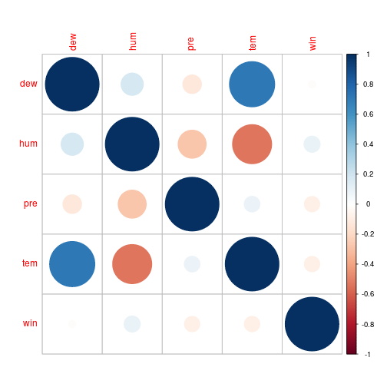
Quantitative Results 1
Set-1: Correlation
Temperature | Dew Point | 71%
Temperature | Humidity | 49.7%
Pressure | Humidity | 36.2%

Slide 7
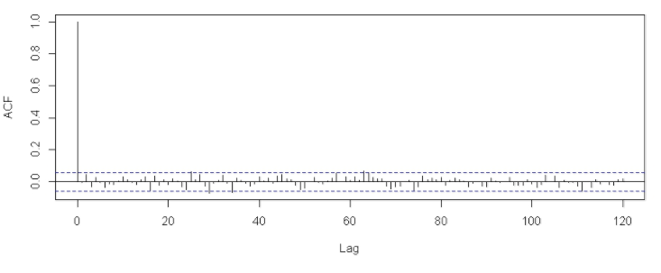
Quantitative Results 2
Set-2: PCA
Variables after applying PCA [Dew-point, Humidity, Pressure.]
Set-3: ARIMA(2,0,1)
Moving Average Terms -> ACF
Auto regressive terms -> PACF
SSE --- 0.213
RMSE --- 1.69
MAE --- 1.2
R^2 --- 0.78
 | ar1 | ar2 | ma1
error | 1.5 | -0.5 | 0.86
Std. error | 0.026 | 0.86 | 0.01

Slide 8
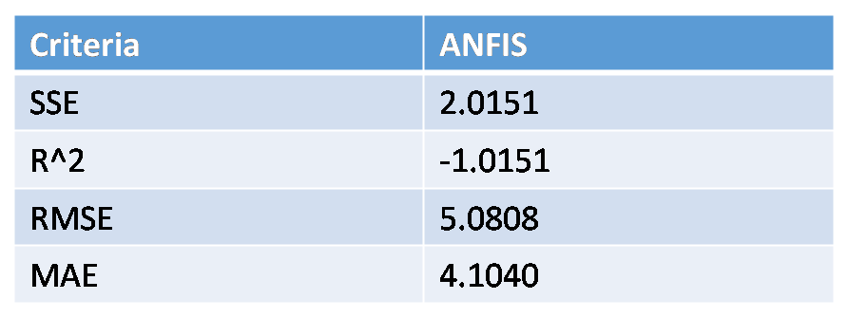
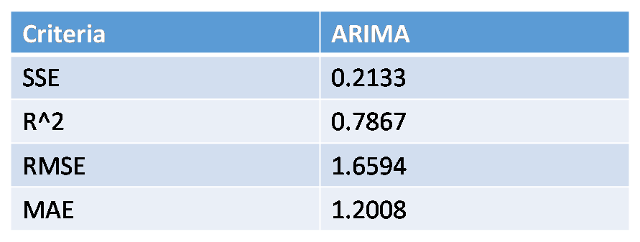
Discussion: Comparison With Your Competitor
Competitor’s Results
Your Results
Error is more because of long range prediction.
Used MATLAB
I predicted for short range of dates.
Used Zeppelin (R, Python)

Slide 9
Performance on Big Data: Time Measurements
Process | Time Measurement | Work Done
Data Loading | 75 sec | Loading six data files into zeppelin
Data Cleaning | 60 sec | Converting JSON format files into DATETIME format files and removing outliers.
Applying Correlation and PCA | 30 sec | Finding correlation between the variables and dimensionality reduction using PCA.
ARIMA | 45 sec | Running time series analysis. ACF, PACF.

Slide 10
Conclusion
As we can see, the results obtained by ARIMA has less error than ANFIS which has been applied by my competitor.
The results are more than thirty percent accurate when compared to competitor article.
Achieved two important points:
I was able to prove ARIMA is better statistical method than ANFIS for this kind of weather forecasting.
Tried to out perform competitor and achieved it.

Slide 11
Quiz for Your Classmates
What statistical method was used?
What programming tool was used?
What scientific contribution was made?
What idea could be useful for your project?

